Slide 1


Estimation and Control of Nonlinear Systems: Model-Based and Model-Free Approaches Doctoral Dissertation Defense
Debdipta Goswami
Department of Electrical and Computer Engineering
Institute for Systems Research
University of Maryland, College Park
May 8, 2020
Dr. Derek A. Paley (Adviser/Chair)
Dr. Perinkulam S. Krishnaprasad
Dr. Nuno M. C. Martins
Dr. Eyad H. Abed
Dr. Nikhil Chopra (Dean’s Representative)

Slide 2
Outline of the dissertation
Estimation and Output Feedback of Nonlinear Systems in Presence of Noise
Model-based Estimation and Controller Design for Nonlinear Systems
Gaussian Mixture Model Kalman Filter (GMM-KF)
Density Transport with Approximate Perron-Frobenius Operator
Estimation and Controller Design for Unmodeled or Partially Modeled System
Data-driven Estimation: Echo-state Network with Ensemble Kalman Filter (ESN-EnKF)
Bilinearization, Controllability, and Optimal Control of a Control Affine System

Slide 3
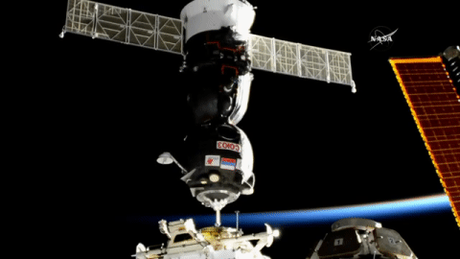
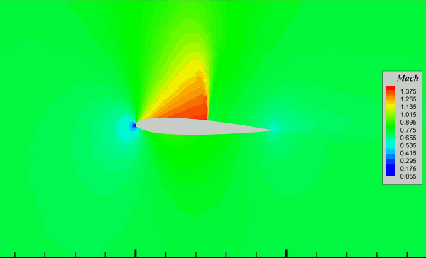
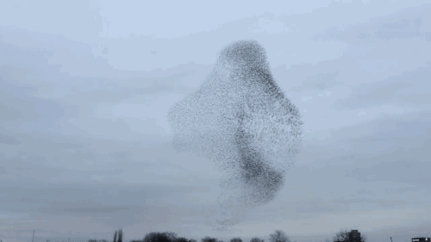
Motivation
Gaussian Mixture Filters
PF Operator Approximation
ESN-EnKF
Koopman bilinearization
Motivation: Estimation and Control of Nonlinear Systems
Control of nonlinear systems is ubiquitous: air and spacecrafts, underwater vehicles, study of the collective behavior, fluid dynamics, and many more.
Every practical feedback control problem needs a state-estimation algorithm.
In today’s world, we would like to control unmodeled systems from ever-growing abundance of data: data-driven algorithms.
Soyuz docking to the Zvezda module of the ISS
Credit: NASA
A pitching NACA 0012 airfoil
Credit: Politechnico di Milano
A flock of starlings
Credit: Simon Coffey, urbanautomation.com

Slide 4
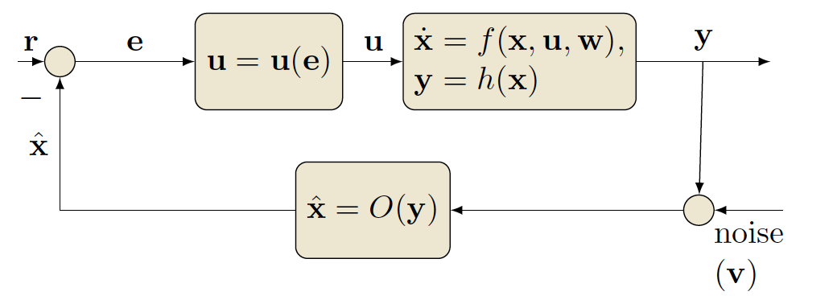
Motivation
Gaussian Mixture Filters
PF Operator Approximation
ESN-EnKF
Koopman bilinearization
Estimation and Control of Nonlinear Systems
4

Slide 5
Motivation
Gaussian Mixture Filters
PF Operator Approximation
ESN-EnKF
Koopman bilinearization
Estimation and Control of Nonlinear Systems
Model-based algorithms
Model-free algorithms
Gaussian mixture-based filters
Perron-Frobenius operator approximation-based methods
Echo-state network-based prediction and estimation
Koopman operator-based model-identification and control design

Slide 6
Motivation
Gaussian Mixture Filters
PF Operator Approximation
ESN-EnKF
Koopman bilinearization
Contributions of the Dissertation
Development a recursive filtering algorithm with the Gaussian Mixture Model (GMM) and provide explicit stochastic bounds
Combining Ulam’s method with Extended Dynamic Mode Decomposition (EDMD) to develop a multi-pass Monte Carlo method with constrained optimization for Perron-Frobenius (PF) operator approximation
Implementation of an output feedback control of a pitching airfoil with the approximate Perron-Frobenius operator
Development of a data-driven estimation method for a partially observed time-series using an Echo-State Network (ESN) and an Ensemble Kalman Filter in feedback
Derivation of a bilinear approximation for a partially modeled control affine nonlinear system with the convergence proof and its application to the controllability analysis and optimal control design

Slide 7
Outline
Estimation and Output Feedback of Nonlinear Systems in Presence of Noise
Model-based Estimation and Controller Design for Nonlinear Systems
Gaussian Mixture Model Kalman Filter (GMM-KF)
Density Transport with Approximate Perron-Frobenius Operator
Estimation and Controller Design for Unmodeled or Partially Modeled System
Data-driven Estimation: Echo-state Network with Ensemble Kalman Filter (ESN-EnKF)
Bilinearization, Controllability, and Optimal Control of a Control Affine System

Slide 8
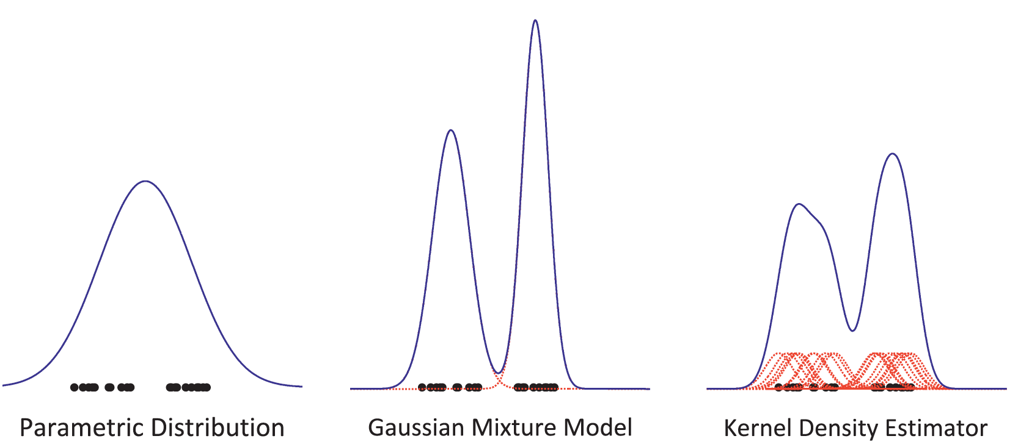
Model-based methods: Gaussian Mixture Model (GMM)
Motivation
Gaussian Mixture Filters
PF Operator Approximation
ESN-EnKF
Koopman bilinearization
GMM converges uniformly to any sufficiently smooth distribution [Alspach and Sorenson, 1972].
Figure: [Sondergaard and Lermusiaux, 2006]

Slide 9
Gaussian Mixture Model: Definition
Motivation
Gaussian Mixture Filters
PF Operator Approximation
ESN-EnKF
Koopman bilinearization
GMM is a weighted sum of Gaussian distribution with weights such that .
, , and are to be determined by Expectation Maximization (EM) algorithm [Dempster 1977].
Mixture complexity is determined by minimizing Bayesian Information Criteria (BIC) [Schwarz 1978].

Slide 10
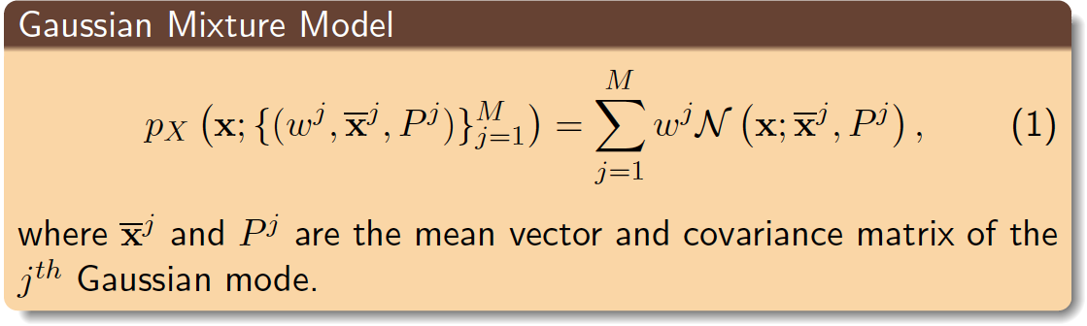
Gaussian Mixture Model: Definition
Motivation
Gaussian Mixture Filters
PF Operator Approximation
ESN-EnKF
Koopman bilinearization
GMM is a weighted sum of Gaussian distribution with weights such that .
, , and are to be determined by Expectation Maximization (EM) algorithm [Dempster 1977].
Mixture complexity is determined by minimizing Bayesian Information Criteria (BIC) [Schwarz 1978].

Slide 11
Relation to Prior Work
Motivation
Gaussian Mixture Filters
PF Operator Approximation
ESN-EnKF
Koopman bilinearization
Nonlinear filter | Process noise | Measurement noise | Resampling | Stochastic bound
Unscented Kalman Filter [Julier et al. 1997] | Gaussian | Gaussian | no | yes
Ensemble Kalman Filter (EnKF) [Dovera et al. 2011, Frei et al.] | Gaussian | Gaussian | optional | yes
Particle filters [Arumpalam et al. 2002, Candy 2002] | Non-Gaussian | Non-Gaussian | required | no
Gaussian Mixture Model Dynamically Orthogonal filter (GMM-DO) [Lermusiaux et al. 2013] | Non-Gaussian | Gaussian | required | no
Gaussian Mixture Model Extended/Unscented Kalman Filter (GMM-EKF, GMM-UKF)^{1, 2} | Non-Gaussian | Gaussian | optional | yes
D. Goswami and D. A. Paley. Non-Gaussian estimation and output feedback using the Gaussian Mixture Model Kalman Filter. Revised manuscript in review in AIAA Journal of Guidance, Control, and Dynamics.
D. Goswami and D. A. Paley. Non-Gaussian estimation and observer-based feedback using the Gaussian Mixture Kalman and Extended Kalman Filters. In Proc. American Control Conf., pages 4550–4555, Seattle, Washington, May 2017.

Slide 12
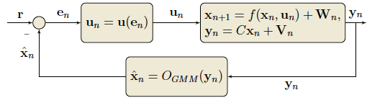
Block diagram: Gaussian Mixture Model EKF/UKF
Motivation
Gaussian Mixture Filters
PF Operator Approximation
ESN-EnKF
Koopman bilinearization
Each Gaussian mode is propagated using Extended or Unscented Kalman Filter for nonlinear dynamics and non-Gaussian noise.
Gaussian #1
EKF/UKF
Weight Updates
EM & BIC
∑
Ensemble realization
Gaussian #2
EKF/UKF
Posterior PDF
.
.
.
.
.
.
Gaussian #M
EKF/UKF
Expectation Maximization & Bayesian Information Criterion
Gaussian Mixture
Propagation
Notes:
EMGM: Expectation Maximisation Alg., BIC: Bayesian Information Criteria

Slide 13
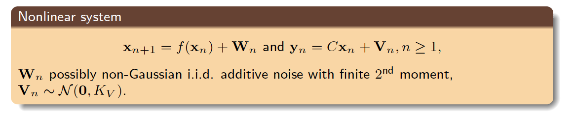
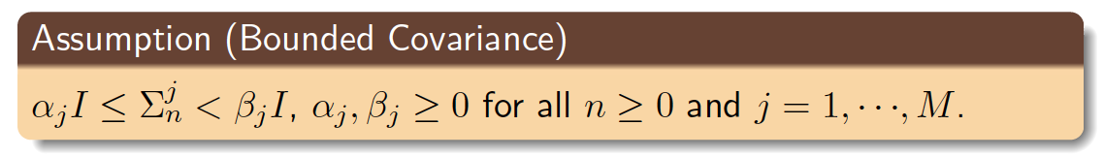
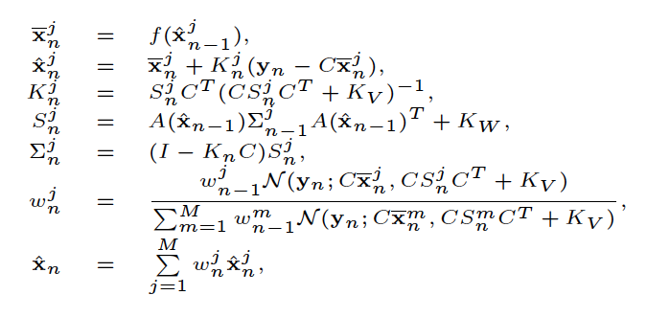
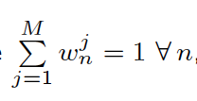
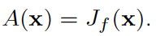
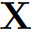
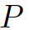
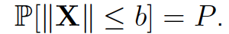
Stochastic Error Bounds: GMM-EKF, GMM-UKF
Motivation
Gaussian Mixture Filters
PF Operator Approximation
ESN-EnKF
Koopman bilinearization
Theorem The error is bounded with probability if has full column rank and is bounded with probability under the assumption.
This theorem is valid for GMM-UKF (when a UKF is used to propagate the mixture components) if the sample covariances of the sigma-points remain bounded.
When the GMM-EKF/UKF estimate is used for output feedback controller with a stabilizing term, the states are also bounded with the probability and the bound depends on the corresponding error bound.
A random vector is bounded by b with probability if
The efficacy of the corresponding stabilizing output feedback control is also investigated.
Notes:
\mathcal{L}_2
V_n

Slide 14
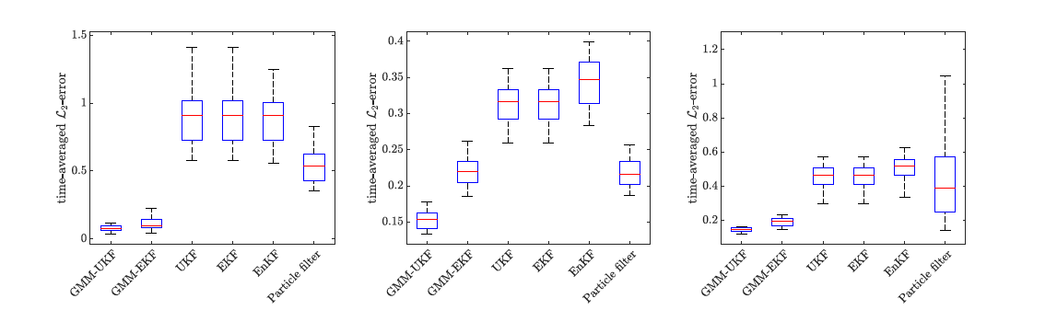
Performance of GMM-EKF, GMM-UKF
Motivation
Gaussian Mixture Filters
PF Operator Approximation
ESN-EnKF
Koopman bilinearization
Duffing map
Power map
Sinusoidal map
Time-averaged error of 50 independent Monte-Carlo runs
GMM-Based filters perform significantly better than EKF, UKF, and EnKF, and similar to or slightly better than particle filters.
Notes:
In high nonlinear scenario, GMM-EKF/UKF performs significantly better than traditional EKF.

Slide 15
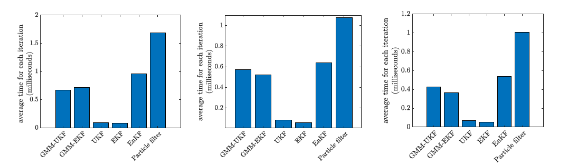
Computational Cost of GMM-EKF, GMM-UKF
Motivation
Gaussian Mixture Filters
PF Operator Approximation
ESN-EnKF
Koopman bilinearization
Duffing map
Power map
Sinusoidal map
Average run-time for each iteration of 50 independent Monte-Carlo runs
GMM-Based filters consume more CPU-time than EKF and UKF, and significantly less than EnKF and particle filters.

Slide 16
Outline
Estimation and Output Feedback of Nonlinear Systems in Presence of Noise
Model-based Estimation and Controller Design for Nonlinear Systems
Gaussian Mixture Model Kalman Filter (GMM-KF)
Density Transport with Approximate Perron-Frobenius Operator
Estimation and Controller Design for Unmodeled or Partially Modeled System
Data-driven Estimation: Echo-state Network with Ensemble Kalman Filter (ESN-EnKF)
Bilinearization, Controllability, and Optimal Control of a Control Affine System

Slide 17
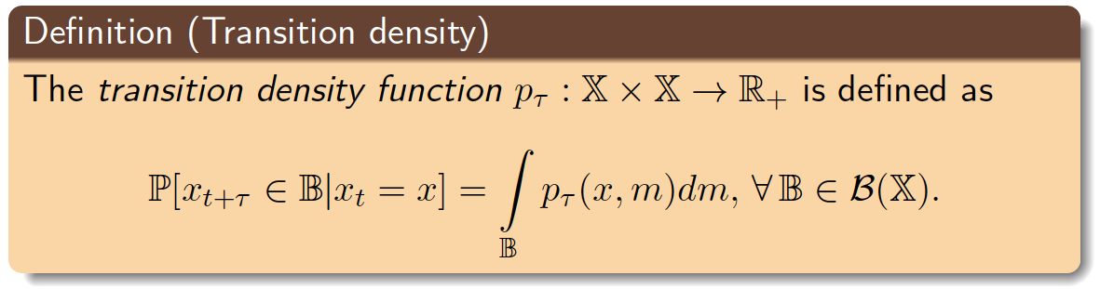
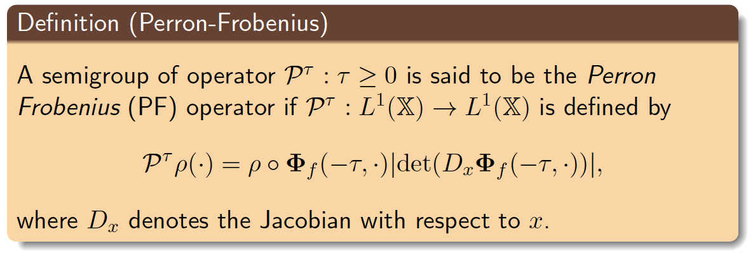
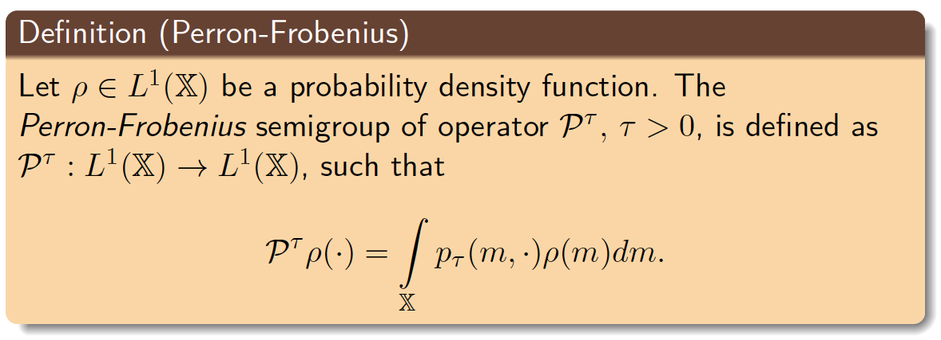
Perron-Frobenius (PF) Operator: Definitions
Motivation
Gaussian Mixture Filters
PF Operator Approximation
ESN-EnKF
Koopman bilinearization
: smooth time-invariant vector fields where is a compact manifold.
Itô stochastic differential equation:
Ordinary differential equation:
,
flow-map:
operates on the density function to propagate it with respect to the differential equation.
Notes:
mathbb{X} \subset \mathbb R^d
f:\mathbb{X}\rightarrow \mathbb{X}
\dot{x}=f(x)
\mathbf{\Phi}_f:\mathbb{R}\times\mathbb{X}\rightarrow\mathbb{X}
\mathcal{P}^{\tau}
Introduce Koopman verbally before the slide

Slide 18
Relation to Prior Work
Motivation
Gaussian Mixture Filters
PF Operator Approximation
ESN-EnKF
Koopman bilinearization
Literature | Algorithm | Monte Carlo method | Time step | Application
Approximation of density transfer operators [Ulam, Froyland et al. 2014] | Ulam’s method | Single step | Long | General purpose method
Finding almost time-invariant set [Froyland et al. 2001, 2009] | Global analysis of invariant object (GAIO) | Single step | Long | Fluid dynamics
Approximation of Koopman operator [Mezić et al. 2005, Rowley et al. 2009, Williams et al. 2015] | Extended Dynamic Mode Decomposition (EDMD) and variants | Multi step | Short | Fluid dynamics
Approximation of PF operator with multi-step Monte-Carlo¹ | Constrained Ulam Dynamic Mode Decomposition (CUDMD) | Multi step | Short | Nonlinear estimation and output feedback
D. Goswami, E. Thackray, and D. A. Paley. Constrained Ulam Dynamic Mode Decomposition: Approximation of Perron-Frobenius Operator for Deterministic and Stochastic Systems. IEEE Control Systems Letters, 2(4):809–814, 2018.

Slide 19
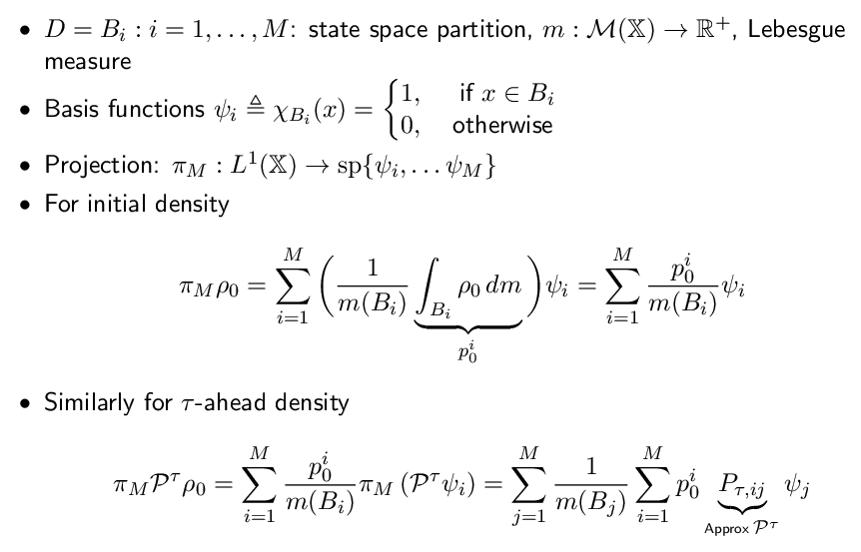
Finite-Dimensional Approximation: Weak Formulation
Motivation
Gaussian Mixture Filters
PF Operator Approximation
ESN-EnKF
Koopman bilinearization

Slide 20
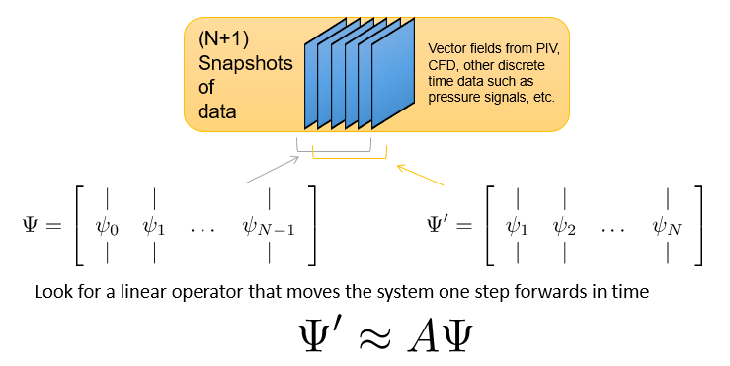
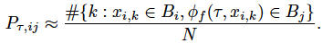
Combining Ulam’s Method and Dynamic Mode Decomposition
Motivation
Gaussian Mixture Filters
PF Operator Approximation
ESN-EnKF
Koopman bilinearization
Koopman operator, PF's dual, is approximated using snapshots of observations using basis functions (Extended Dynamic Mode Decomposition).
We apply the same using snapshots of Monte Carlo simulations.
propagated forward
N Particles in each grid B_{i}, i=1,...M
Particles redistributed
Time 0
Time 𝞃
Ulam’s method
Extended DMD

Slide 21
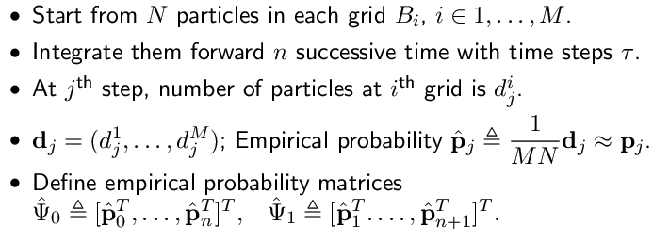
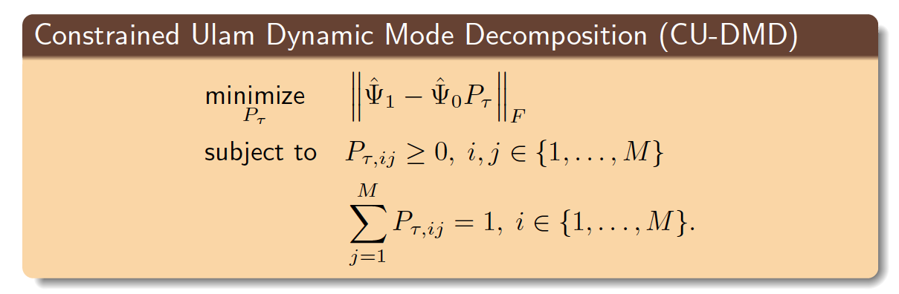
Constrained Ulam Dynamic Mode Decomposition (CU-DMD)
Motivation
Gaussian Mixture Filters
PF Operator Approximation
ESN-EnKF
Koopman bilinearization

Slide 22
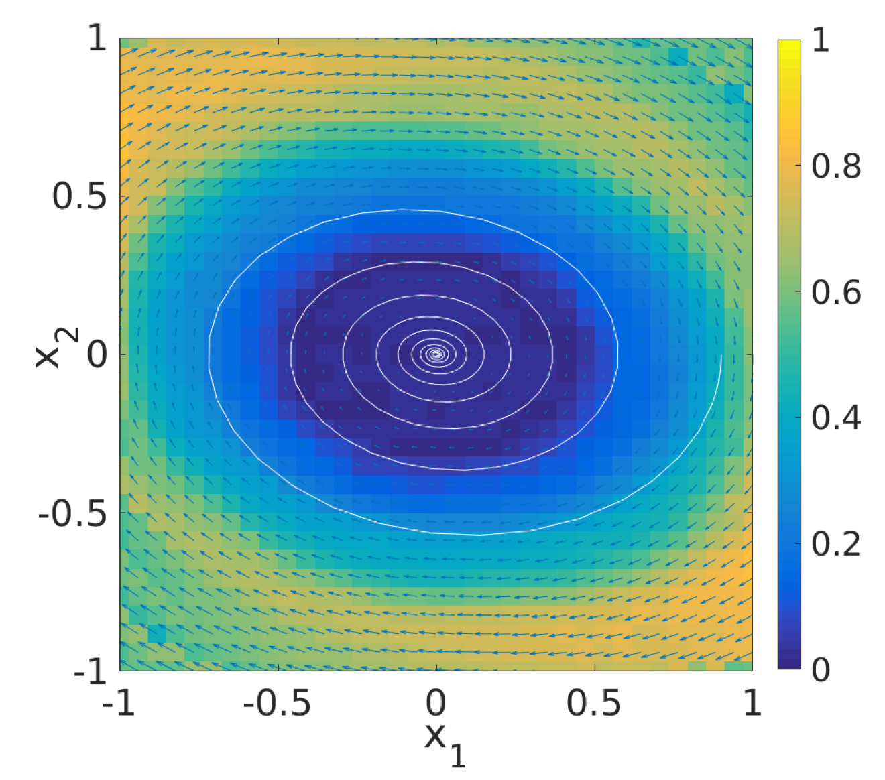
Numerical Example: Linear System
Motivation
Gaussian Mixture Filters
PF Operator Approximation
ESN-EnKF
Koopman bilinearization
,
PF Eigenvalue | Error from Ulam’s method | Error from CU-DMD
Error comparison of eigenfunctions for the linear system
Second order linear system: eigenfunction corresponding to
Notes:
\dot{x}=Ax
A=\begin{bmatrix} 0 & 1 \\ -0.5 & -0.1 \end{bmatrix}
x\in\mathbb R^2
\lambda=0.89\pm i0.06

Slide 23
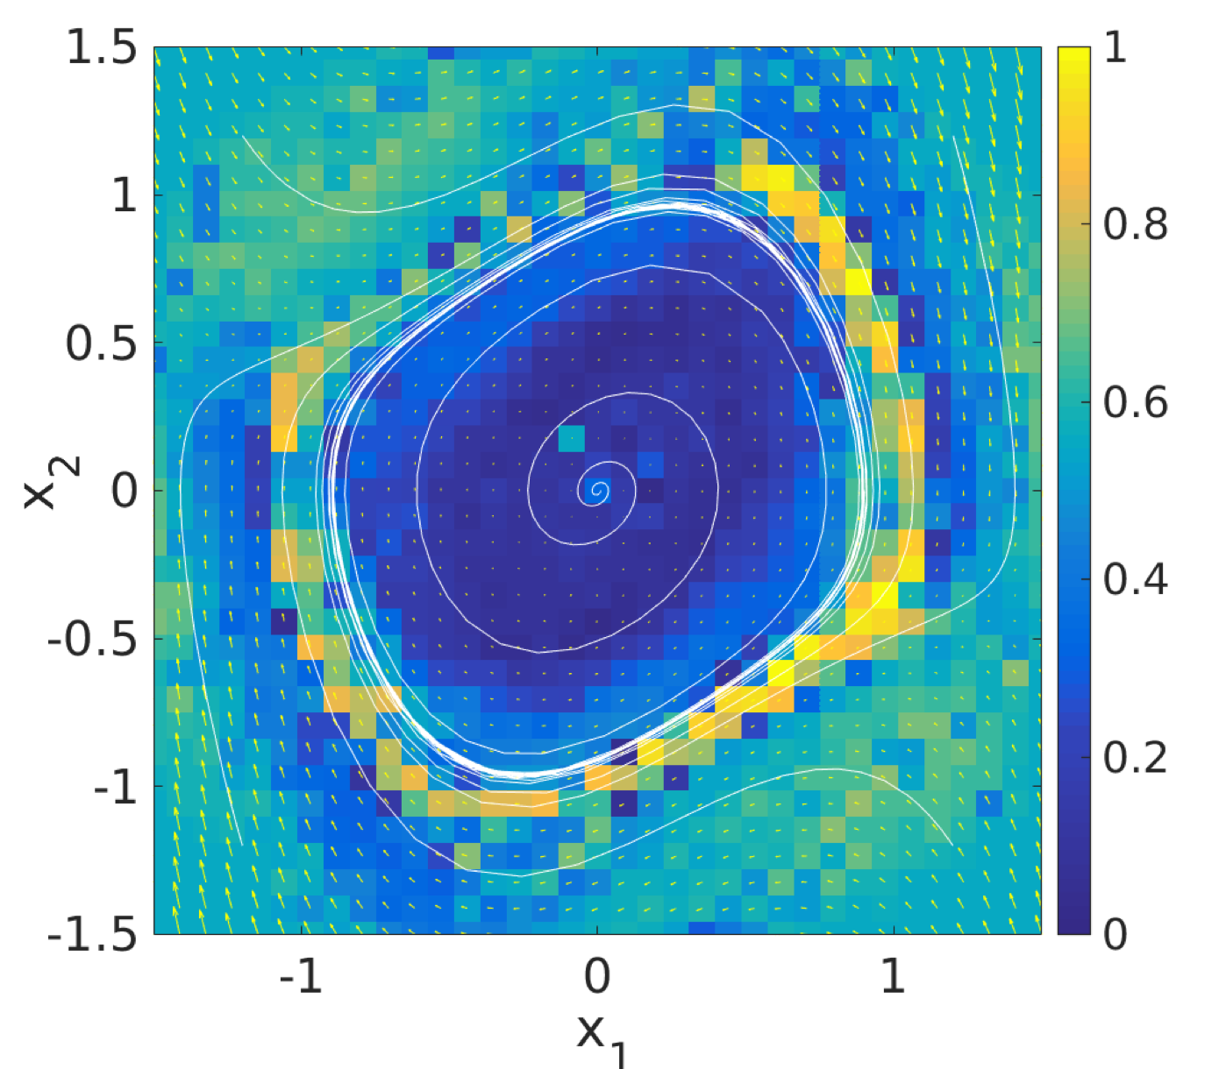
Numerical Example: Stochastic Van der Pol Oscillator
Motivation
Gaussian Mixture Filters
PF Operator Approximation
ESN-EnKF
Koopman bilinearization
Stochastic Van der Pol system: Dominant spectra with unity eigenvalue circled (left) and the corresponding eigenfunction (right)
Notes:
dx_t=f(x_t)dt + \sqrt{2\sigma} dw_t,\,t>0,
f(x)=\begin{bmatrix} x_2 \\ m(c-x_1^2)x_2-x_1 \end{bmatrix}

Slide 24
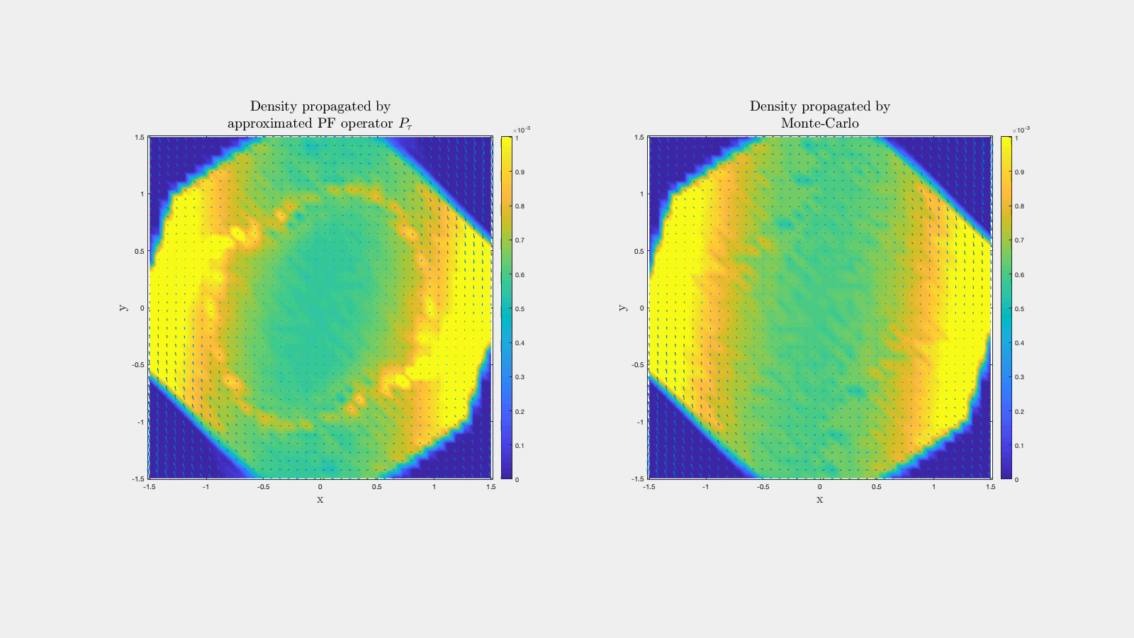
Density transport for a Van der Pol oscillator
Motivation
Gaussian Mixture Filters
PF Operator Approximation
ESN-EnKF
Koopman bilinearization

Slide 25
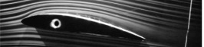
Numerical Example: Feedback Control of A Pitching airfoil¹
Motivation
Gaussian Mixture Filters
PF Operator Approximation
ESN-EnKF
Koopman bilinearization
with Justin Lidard, BS student in Aerospace Engineering
Attached Flow
Separation Point
Separated Region
Goal: Use state-space model (Goman, 1994) of high angle-of-attack to design output feedback control for lift maximization
Nonlinearities in lift coefficient allow for increased average lift using periodic oscillations about a static equilibrium
Pitch feedback control to stabilize limit cycle behavior yields ~40% improvement in lift compared to static pitch angles
Output feedback achieved by Bayesian filtering: motion update accomplished by CU-DMD
J. Lidard, D. Goswami, D. Snyder, G. Sedky, A. Jones, and D. A. Paley. Output feedback control for lift maximization of a pitching airfoil. In Proc. AIAA SciTech, number AIAA-2020-1836, pages 1–13, Orlando, Florida, 2020.

Slide 26
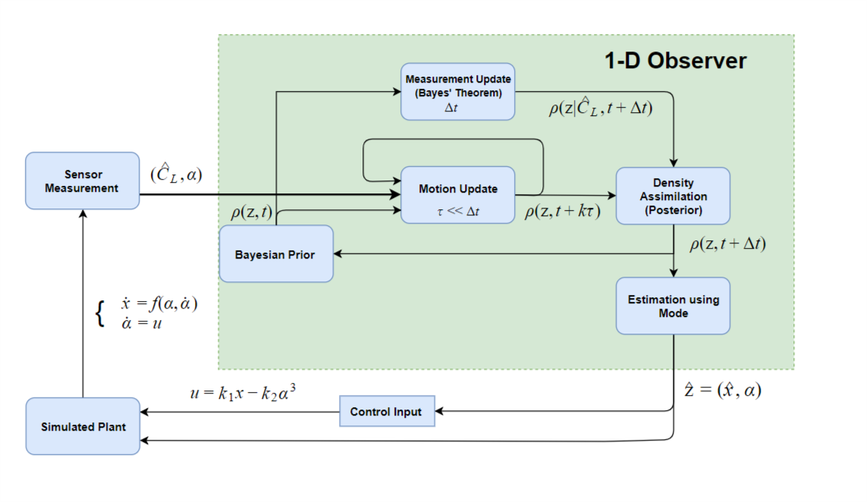
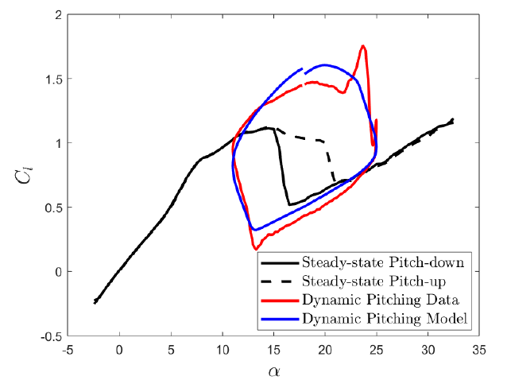
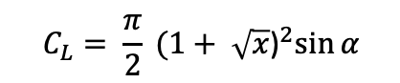
Goman-Khrabrov Model and Output Feedback
Motivation
Gaussian Mixture Filters
PF Operator Approximation
ESN-EnKF
Koopman bilinearization
Flow separation
Angle of attack
State feedback undergoes Hopf bifurcation
$$C_{L}= \frac{π}{2} {(1+ \sqrt{x}\text{)}}^{2}\sin{α}$$
Lift-coefficient: measured
Goman-Khrabrov Model
Lift hysteresis occurs during rapid pitching

Slide 27
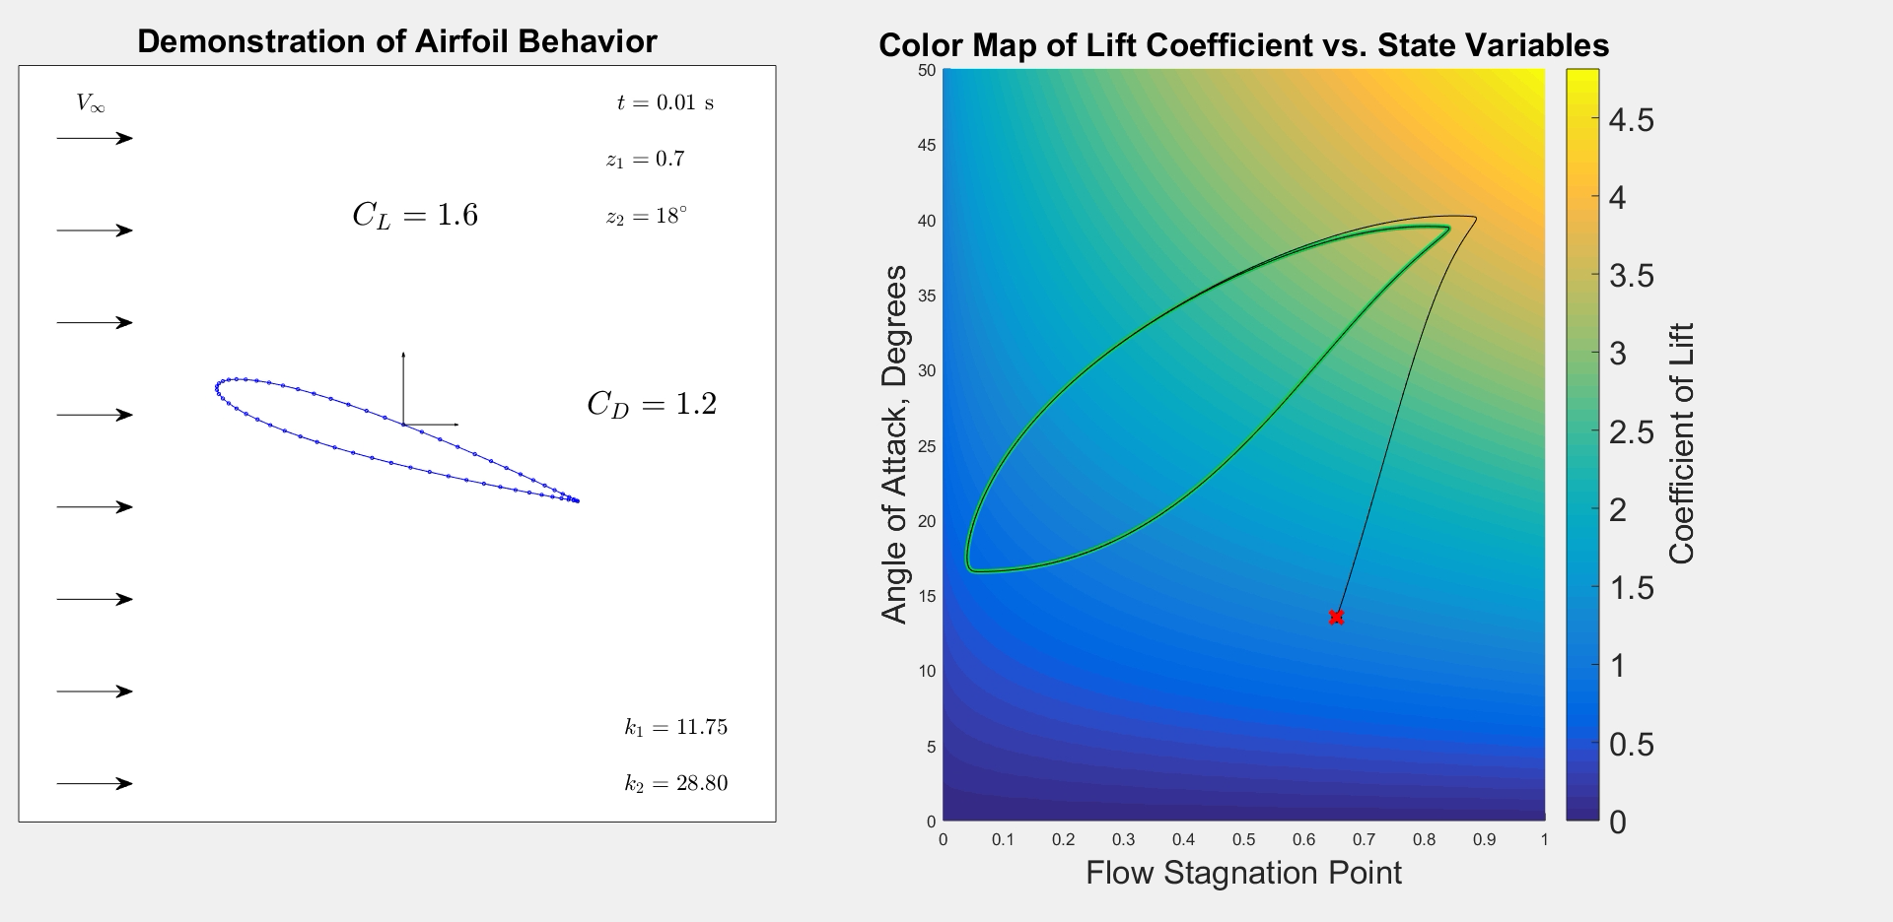
Output Feedback Performance using CU-DMD
Motivation
Gaussian Mixture Filters
PF Operator Approximation
ESN-EnKF
Koopman bilinearization

Slide 28
Outline
Estimation and Output Feedback of Nonlinear Systems in Presence of Noise
Model-based Estimation and Controller Design for Nonlinear Systems
Gaussian Mixture Model Kalman Filter (GMM-KF)
Density Transport with Approximate Perron-Frobenius Operator
Estimation and Controller Design for Unmodeled or Partially Modeled System
Data-driven Estimation: Echo-state Network with Ensemble Kalman Filter (ESN-EnKF)
Bilinearization, Controllability, and Optimal Control of a Control Affine System

Slide 29
Motivation
Gaussian Mixture Filters
PF Operator Approximation
ESN-EnKF
Koopman bilinearization
Data-driven Estimation and Control

Slide 30
Motivation
Gaussian Mixture Filters
PF Operator Approximation
ESN-EnKF
Koopman bilinearization
Approaches Considered: Neural Network and Koopman Lifting
High dimensional (n)
High Dimensional Neural Network Dynamics (nonlinear)
Koopman Lifting
Low dimensional (d)
Low dimensional (d)
Low dimensional (d)
Neural network approach
Koopman spectral approach

Slide 31
Echo-State Network: A Lifting Approach
Motivation
Gaussian Mixture Filters
PF Operator Approximation
ESN-EnKF
Koopman bilinearization
Random
Trained
Input vector
Output vector

Slide 32
Echo-State Network: A Free-running Predictor
Motivation
Gaussian Mixture Filters
PF Operator Approximation
ESN-EnKF
Koopman bilinearization

Slide 33
Relation to Prior Work
Motivation
Gaussian Mixture Filters
PF Operator Approximation
ESN-EnKF
Koopman bilinearization
Literature | Principal contribution | Measurements | Applications
ESN as a liquid state machine (LSM) [Maas et al. 2004] | Universal filter construction, fading memory | no | Neural signal processing
ESNs are universal [Grigoryeva et al. 2018] | Universal functional approximation | no | N/A
ESN for model-free prediction [Pathak et al. 2018] | Reservoir predictor algorithm | no | Chaos prediction
ESN-based prediction for unmeasured variables [Lu et al. 2017] | Reservoir observer algorithm | yes | Chaos prediction
ESN with Ensemble Kalman Filter in feedback¹ | ESN-EnKF algorithm | yes | Chaos prediction, traffic congestion prediction
D. Goswami, A. Wolek, and D. A. Paley. Data-driven estimation using an Echo-State Neural Network equipped with an Ensemble Kalman Filter. Submitted to IEEE Conference on Decision and Control, 2020.
Notes:
Take out theoretical contribution/change it to something else

Slide 34
Echo-State Network with Ensemble Kalman Filter
Motivation
Gaussian Mixture Filters
PF Operator Approximation
ESN-EnKF
Koopman bilinearization
Ensemble Kalman Filter

Slide 35
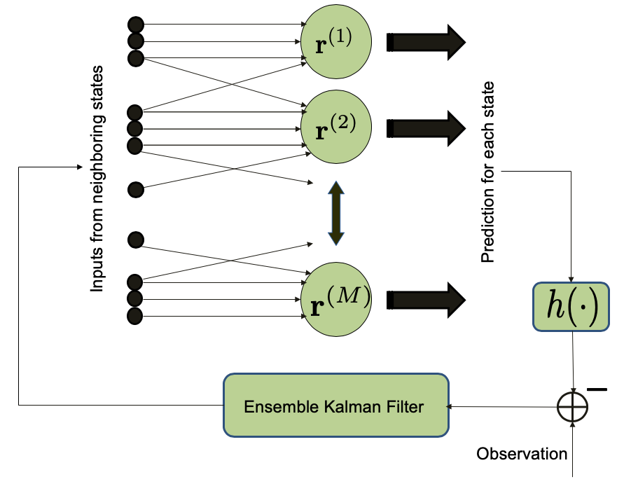
Parallel ESNs with Ensemble Kalman Filter
Motivation
Gaussian Mixture Filters
PF Operator Approximation
ESN-EnKF
Koopman bilinearization
Lorenz-96 System [Lorenz, 1996]

Slide 36
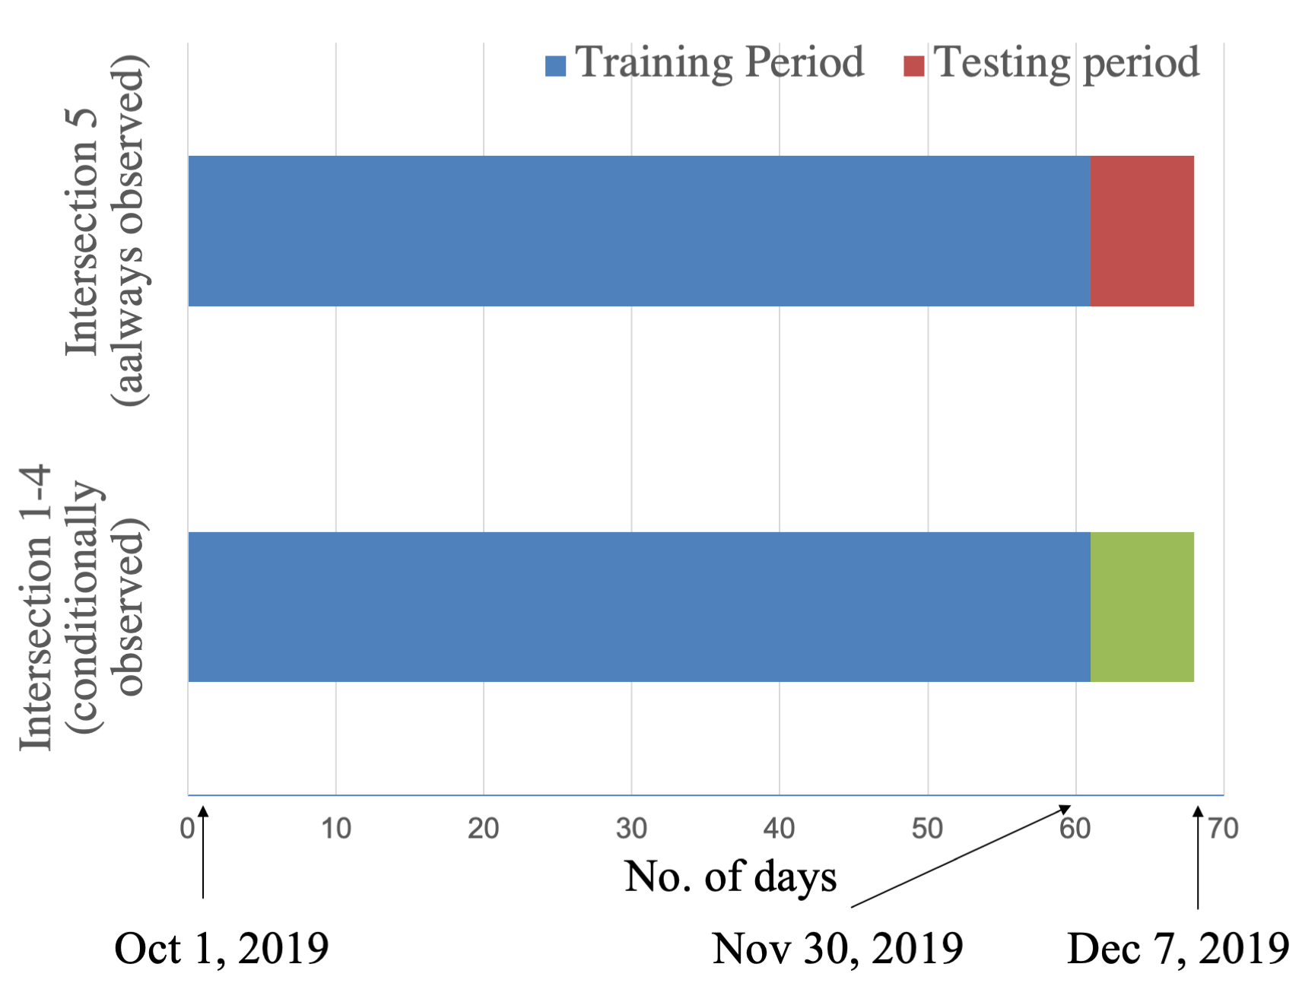
Application: Traffic Congestion Prediction with Numina
Motivation
Gaussian Mixture Filters
PF Operator Approximation
ESN-EnKF
Koopman bilinearization
Credit: Dr. Artur Wolek

Slide 37
Application: Traffic Congestion Prediction with Numina
Motivation
Gaussian Mixture Filters
PF Operator Approximation
ESN-EnKF
Koopman bilinearization
Correlation between the predicted and estimated congestion increases as the number of available sensors increases
denotes the number of vehicles per hour at intersection. Intersection 5 is observed.

Slide 38
Outline
Estimation and Output Feedback of Nonlinear Systems in Presence of Noise
Model-based Estimation and Controller Design for Nonlinear Systems
Gaussian Mixture Model Kalman Filter (GMM-KF)
Density Transport with Approximate Perron-Frobenius Operator
Estimation and Controller Design for Unmodeled or Partially Modeled System
Data-driven Estimation: Echo-state Network with Ensemble Kalman Filter (ESN-EnKF)
Bilinearization, Controllability, and Optimal Control of a Control Affine System

Slide 39
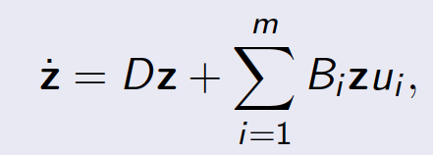
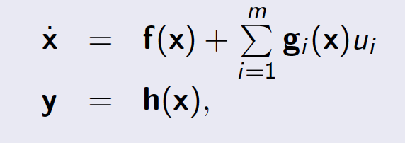
Data-driven Bilinearization of a Control Affine system
Motivation
Gaussian Mixture Filters
PF Operator Approximation
ESN-EnKF
Koopman bilinearization
Bilinearization of a control affine nonlinear system from the data snapshots using Koopman eigenfunctions.
Bilinear system is of higher dimension than the original system.
Eigenfunctions and drift D matrix is calculated from data snapshots using EDMD.
B_{i} s are computed by solving a least squares problem.
Convergence is shown through the universal functional approximation property of the Koopman eigenfunctions.
Optimal control on the bilinear system is designed with Pontryagin’s Principle.
Koopman Canonical Transform + Least Squares
Koopman Bilinear Form (KBF)
Notes:
Only data snapshot from autonomous system is necessary to construct the Koopman Bilinear Form

Slide 40
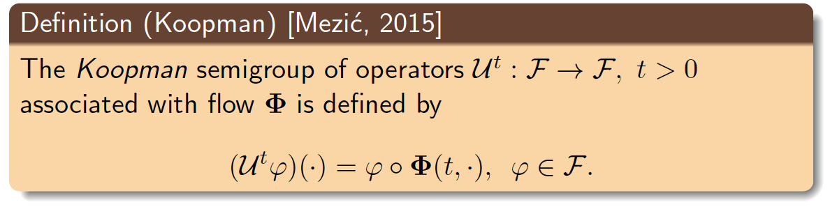
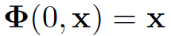
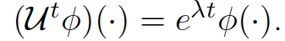
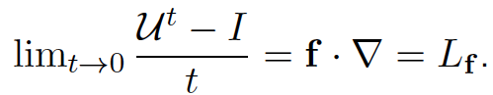
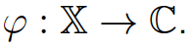
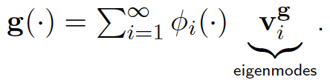
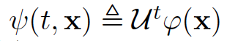
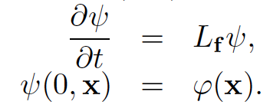
Koopman Operator: An Overview
Motivation
Gaussian Mixture Filters
PF Operator Approximation
ESN-EnKF
Koopman bilinearization
Compact manifold
Flow map:
Linear operator, eigenvalue-eigenfunction pairs:
Infinitesimal generator:
Vector-valued observable:
Time-varying observable:
is a Banach space of complex-valued observables

Slide 41
Relation to Prior Work
Motivation
Gaussian Mixture Filters
PF Operator Approximation
ESN-EnKF
Koopman bilinearization
Literature | Theoretical contribution | Application
Koopman spectral properties [Mezić et al. 2005] | Spectral properties of transfer operators in dynamical system | Fluid dynamics
Spectral properties of nonlinear flow [Rowley et al. 2009] | Justification of Dynamic Mode Decomposition (DMD) with Koopman spectral theory | Fluid dynamics, model reduction
Extended Dynamic Mode Decomposition (EDMD) [Williams et al. 2015] | Extending DMD to accommodate more diverse nonlinear dynamical systems | Data-driven model identification and reduction
Koopman Canonical Transform (KCT) [Surana et al. 2016] | Derivation of a Koopman-based transform to linearize the drift term of a control-affine system | Nonlinear observer design
Koopman Bilinear Form (KBF) [Goswami et al.]^{1, 2} | Derivation of the bilinearizability conditions of KCT, proof of the universal approximator property of the KCT, controllability analysis, and optimal control design. | Data-driven nonlinear control for partially modeled control-affine systems
D. Goswami and D. A. Paley. Global bilinearization and controllability of control-affine nonlinear systems: A Koopman spectral approach. In Proc. IEEE Conf. Decision and Control, pages 6107–6112, Melbourne, Australia, December 2017.
D. Goswami and D. A. Paley. Global bilinearization, reachability, and optimal control of control-affine nonlinear systems: a Koopman spectral approach. Submitted to the IEEE Transactions on Automatic Control.

Slide 42
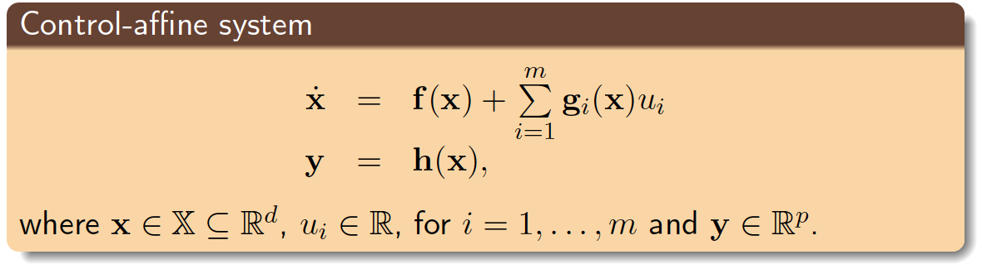
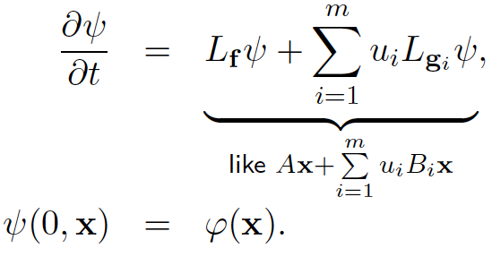
Control Affine System
Motivation
Gaussian Mixture Filters
PF Operator Approximation
ESN-EnKF
Koopman bilinearization

Slide 43
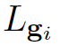
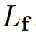
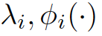





Koopman Canonical Transform
Motivation
Gaussian Mixture Filters
PF Operator Approximation
ESN-EnKF
Koopman bilinearization
Project the infinite-dimensional operators on a finite-dimensional basis.
Eigenvalue-function pairs of (Koopman operator for the unactuated system):
Assumption [Surana 2016]:
The Transformed System
if complex
if complex
Notes:
\mathbf{x}=\sum\limits_{i=1}^n \phi_i(\mathbf{x})\mathbf{v}_i^{\mathbf{x}},\,\,\,\mathbf{h}(\mathbf{x})=\sum\limits_{i=1}^n \phi_i(\mathbf{x})\mathbf{v}_i^{\mathbf{h}},
\mathbf{v}_i^{\mathbf{x}}\in\mathbb{C}^d,\,\mathbf{v}_i^{\mathbf{h}}\in\mathbb{C}^p.
\mathbf{x}&=C^{\mathbf{x}}\mathbf{z},\\
\dot{\mathbf{z}}&= D\mathbf{z} + \sum\limits_{i=1}^mL_{\mathbf{g}_i}T(\mathbf{x})u_i|_{\mathbf{x}=C^{\mathbf{x}}\mathbf{z}},\\
\mathbf{y}&=C^{\mathbf{h}}\mathbf{z}.

Slide 44

Bilinearizability Results: Koopman Bilinear Form (KBF)
Motivation
Gaussian Mixture Filters
PF Operator Approximation
ESN-EnKF
Koopman bilinearization
Theorem:
Eigenspace of is invariant under .
Theorem:
There exists n eigenfunctions
of such that their span is invariant under .
The transformed system is bilinearizable in countable basis
The transformed system is bilinearizable in an -dimensional state space.
This theorem assumes for some . If it is not satisfied, approximate bilinearization:
Koopman Bilinear Form (KBF)
where is a truncation of such that .
Notes:
L_\mathbf{f}
L_{\mathbf{g}_i}
\{\phi_i|i=1\ldots,n\}
L_{\mathbf{g}_i}T(\mathbf{x})=B_iT(\mathbf{x})
B_i
\mathbf{X}
\mathbb{X}
m(\mathbf{X})<\infty
\dot{\mathbf{z}} = D\mathbf{z} + \sum\limits_{i=1}^m B_i\mathbf{z}u_i,\,\,\mathbf{z}\in\mathbb{R}^n,\, n<\infty.

Slide 45

Data-driven Construction of the Koopman Bilinear Form
Motivation
Gaussian Mixture Filters
PF Operator Approximation
ESN-EnKF
Koopman bilinearization

Slide 46

Convergence of the KBF: Functional Approximation
Motivation
Gaussian Mixture Filters
PF Operator Approximation
ESN-EnKF
Koopman bilinearization
Question: Is the span of the Koopman eigenfunctions rich enough to approximate continuous functions of ?
Non-recurrent set
Theorem: , , : Non-recurrent closed set.
: a dense-unital subalgebra; dense in .
Notes:
\mathbf{\Phi}(t,\mathbf{x}_0)
\mathbf{x}_0
\Lambda\subset\mathbb{C}
L(\Lambda)\triangleq\{\sum\limits_{k=1}^{N}\alpha_k\lambda_k | \lambda_k\in\Lambda, \alpha_k\in \mathbb{N}_0, N\in\mathbb{N}\}
\Gamma\subset\mathb{X}
G\subset \mathcal{C}(\Gamma)
\mathbf{\Phi}_{\Lambda, G}\triangleq\{\phi_{\lambda,g}|\lambda\in L(\Lambda), g\in G\}
\mathcal{C}(X_T)
X_T

Slide 47


Optimal Control of the Koopman Bilinear Form
Motivation
Gaussian Mixture Filters
PF Operator Approximation
ESN-EnKF
Koopman bilinearization

Slide 48




Optimal Control with KBF: Numerical Example
Motivation
Gaussian Mixture Filters
PF Operator Approximation
ESN-EnKF
Koopman bilinearization
Controlled Pendulum
Controlled Van der Pol Oscillator
The KBF is computed from the data snapshots with using a dictionary of monomials up to 5th degree.
Notes:
EDMD with monomials up to 5th degree (i.e., 21 monomials), single shooting method for PMP.
Added benefit to a nonlin opt control

Slide 49
Conclusion
Motivation
Gaussian Mixture Filters
PF Operator Approximation
ESN-EnKF
Koopman bilinearization
Summary of contributions
Estimation and output feedback control: Model-based and data-driven
Gaussian mixture model with Kalman filter variants
Perron-Frobenius operator approximation; application in airfoil lift control
Echo-state network-based data-driven estimation for complex systems; application in traffic network
Koopman spectral approach in system identification and controller design
Ongoing and future work
Gaussian mixture model for nonlinear observations
Convergence analysis of operator-approximation-based output-feedback
Neural network-based optimal control design
Optimal sensor placement in traffic network by empirical observability
Extension of Koopman operator theory for systems with arbitrary control input

Slide 50

Acknowledgements
Rabindranath Tagore
Bard of Bengal
Adviser: Dr. Derek A. Paley
Committee members:
Dr. Perinkulam S. Krishnaprasad
Dr. Nuno M. C. Martins
Dr. Eyad H. Abed
Dr. Nikhil Chopra
Collaborators:
Dr. Artur Wolek (Traffic prediction project)
Sheng Cheng (Cooperative search and tracking project, not in the dissertation)
Justin Lidard (Airfoil control project)
Emma Thackray (PF operator approximation)
Dr. André L. Tits
Current and former CDCL members
Family and friends
“তোমার পায়ের পাতা সবখানে পাতা
কোনখানে রাখব প্রণাম?”

